Slide 1
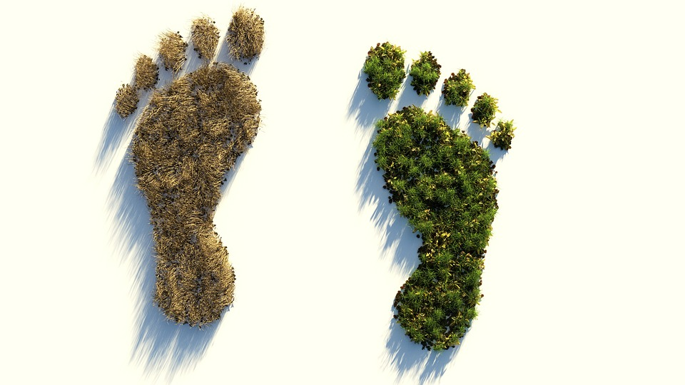
Global Ecological
Mackenzie Mitchell & Jon Bebi

Slide 2
How can countries reduce their ecological footprint?
Multiple linear regression model analysis

Slide 3
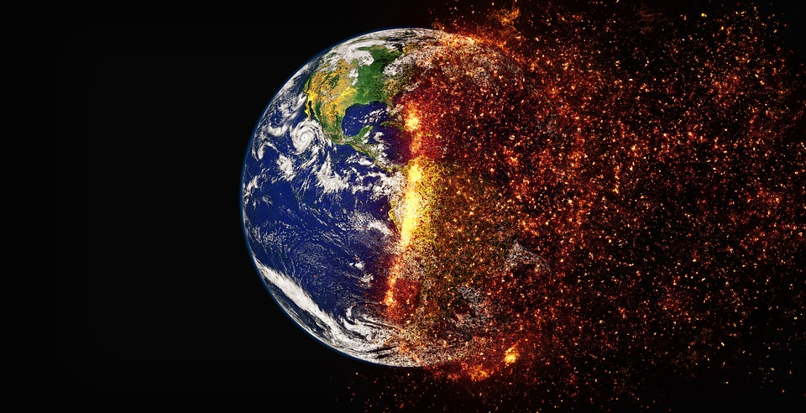
Global Warming
Notes:
With the issue of global warming on the rise, it is important for countries to assess the steps that they can take in order to play their part in reducing this phenomenon.
By analyzing a few variables measured in global hectares, we can predict what actions countries could take in order to reduce the carbon emissions that they produce.
Target variable: Global hectares of additional forest needed to absorb the carbon emitted from the country. (Global hectares of carbon minus global hectares of forest)
Through multiple regression analysis, we were able to create a model to predict the additional global hectares of forest needed to absorb the global hectares of carbon emitted for a given country.

Slide 4
Definitions
The Global Hectare (gha) is a unit of land normalized by biological productivity across land type, country and year.
The Ecological Footprint is the area required to provide the ecological services (resource regeneration and waste assimilation) consumed by humanity.
Biocapacity is how much biologically productive area exists to provide these ecological services each year.

Slide 5

Exploratory Questions
01
What variables are most important when attempting to reduce excess carbon?
02
Has excess carbon been increasing over the years?
03
Are the countries that use a small amount of fishing ground countries that are not surrounded by water?

Slide 6
What variables are most important when attempting to reduce excess carbon global hectares?

Slide 7
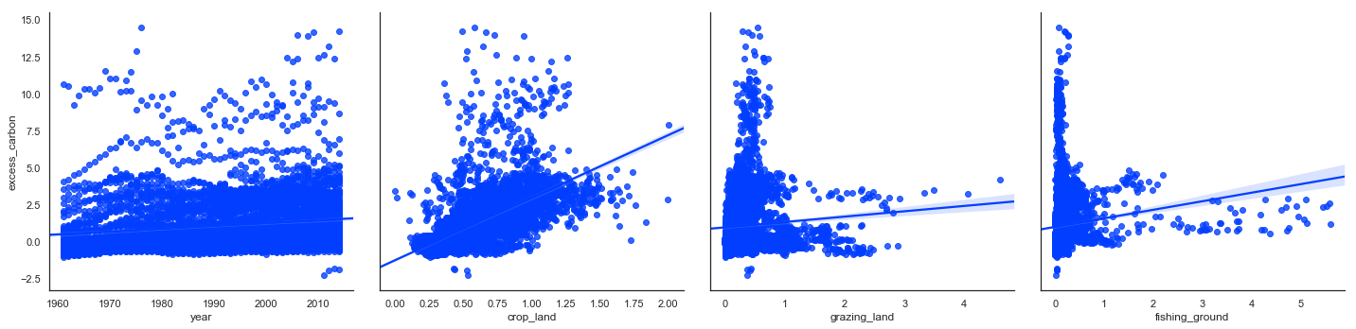
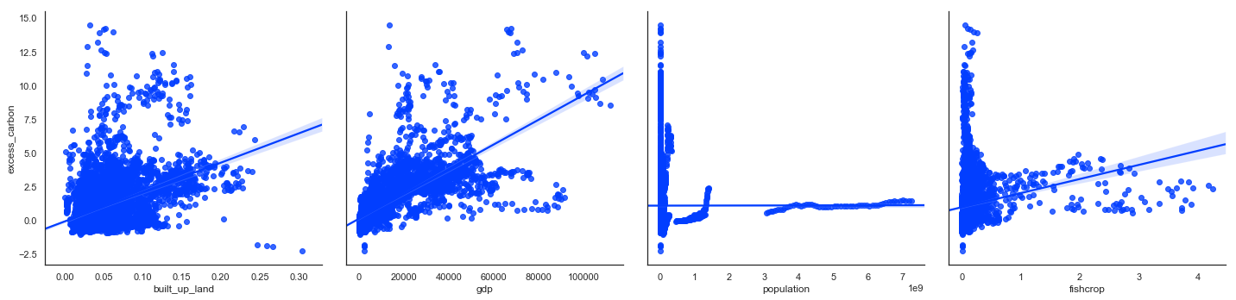

Slide 8
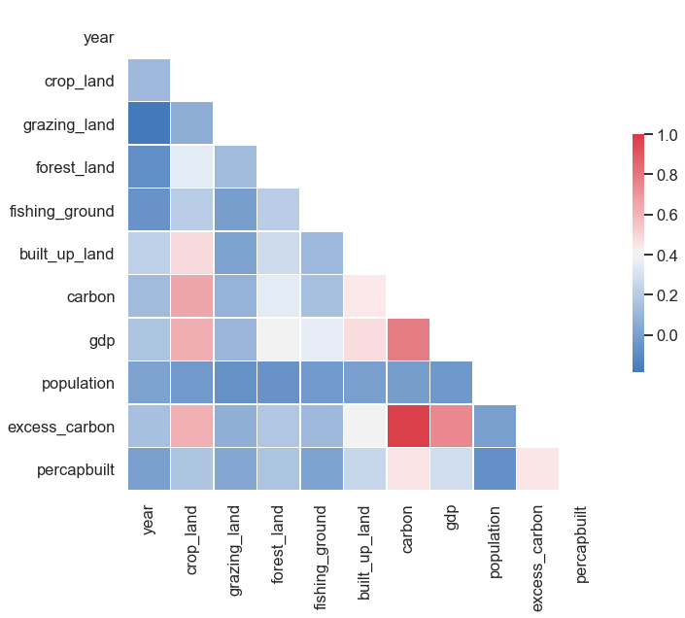
Notes:
By examining the correlation matrix in which the darker the red, the higher correlation, and, the darker the blue, the lower the correlation, it can be preliminarily inferred that the GDP has the largest effect on excess carbon. After that, it can be inferred that the crop land has the second largest impact on excess carbon.

Slide 9
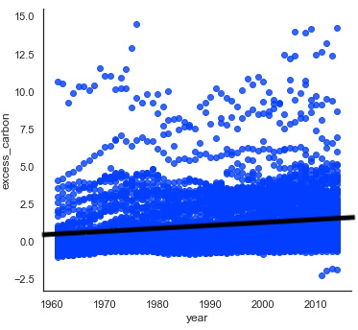
Have excess carbon global hectares been increasing over the years?

Slide 10
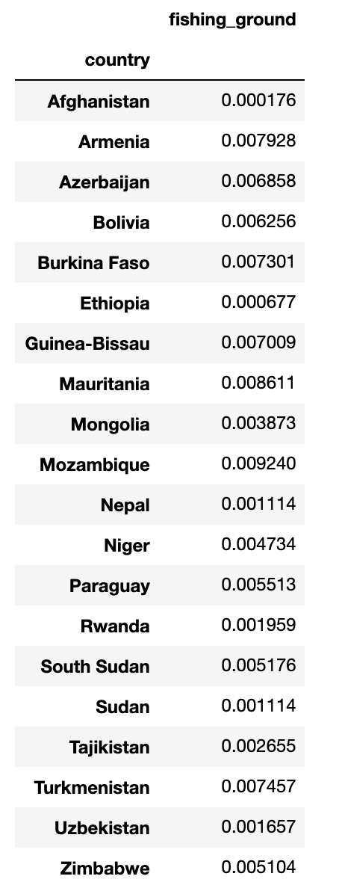
Are the countries that use a small amount of fishing ground countries that are not surrounded by water?
Countries where the average fishing ground over all years is less than 0.01 gha.

Slide 11
The Predicting Model
-5
Excess Carbon = 1.8631 (Crop Land) + 7.21e (GDP) - 0.2059 (Fishing Ground)
+ 1.169e (Per-capita Built-up Land)
- 30.5650 (All Land Types Interaction) - 0.7891
7
Excess Carbon = Carbon - Forest Land
All Land Types Interaction = Crop Land x Fishing Ground x Built-up Land x Grazing Land
68.7%
of the variation in Excess Carbon is explained by our model.

Slide 12
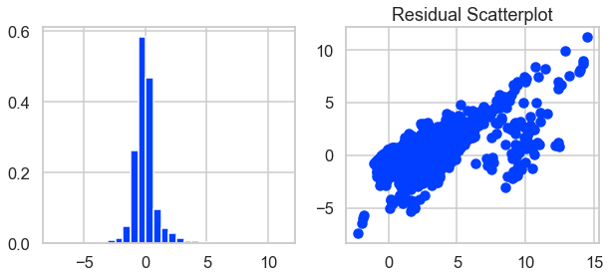
Error trends
Residuals seem to be positively correlated.
After many variations transformations and interaction terms were tested, we have concluded that this data is not best fit using linear regression.

Slide 13
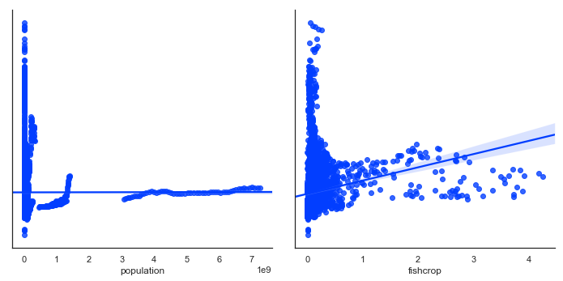
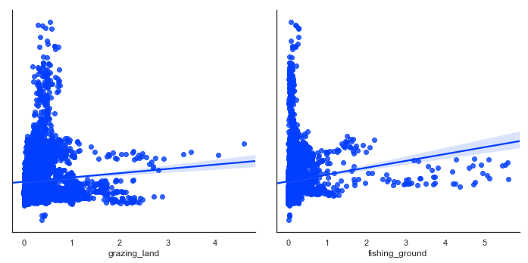
Other Models
Ridge Regression
A multiple regression technique for analyzing data that experiences strong multicollinearity.
Time series
An L-shaped scatter plot represents sudden changes in the relationship between two time series.

Slide 14
Conclusion
Actual model:
Multiple linear regression model (predicts almost 70%)
Suggested model:
Time series or ridge regression
Data heavily related to time
Underlying multicollinearity in predictor variables

Slide 15
